Slide 1

ARTIFICIAL INTELLIGENCE Vs. MACHINE LEARNING Vs. DEEP LEARNING
EASY
ADVANCED

Slide 2
ARTIFICIAL INTELLIGENCE Vs. MACHINE LEARNING Vs. DEEP LEARNING Vs. DATA SCIENCE
ARTIFICIAL INTELLIGENCE (AI)
MACHINE LEARNING (ML)
DATA SCIENCE (DS)
DEEP LEARNING (DL)

Slide 3
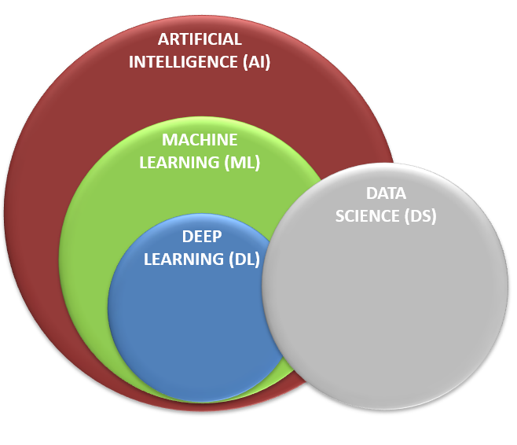

ARTIFICIAL INTELLIGENCE (AI)
AI is the science that enable computers to think like humans.
AI allows computers to imitate human intelligence and do things that humans do!
AI can make decision (Example: buy/sell stocks), understand text (Example: read articles), and detect faces.
Photo Credit: https://pixabay.com/illustrations/artificial-intelligence-brain-think-4111582/

Slide 4
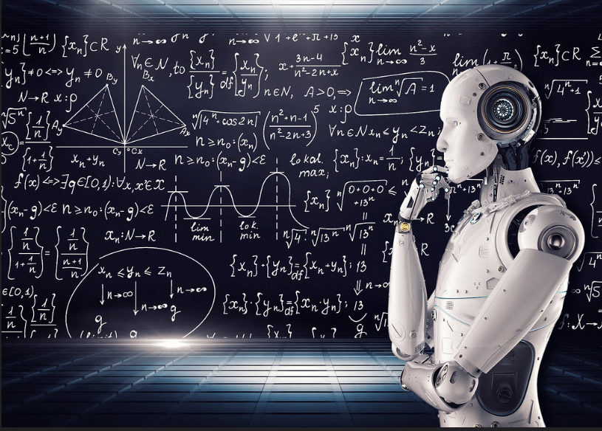
MACHINE LEARNING (ML)
Machine Learning is a subfield of Artificial Intelligence that enables machines to improve at a given task with experience without being explicitly programmed.
Note that all machine learning techniques are classified as Artificial Intelligence. However, not all Artificial Intelligence could count as Machine Learning since some basic Rule-based algorithms could be classified as AI but they do not learn from experience therefore they do not belong to the machine learning category.
Photo Credit: https://www.flickr.com/photos/mikemacmarketing/30212411048

Slide 5
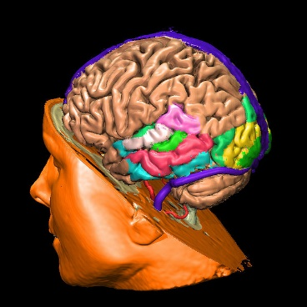
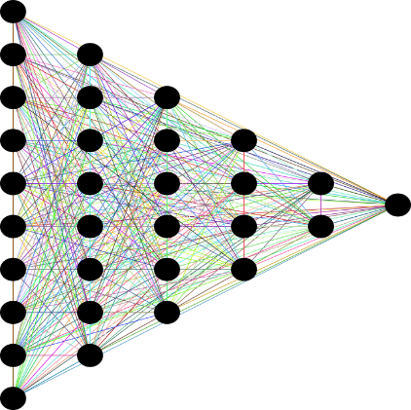
DEEP LEARNING (DL)
Deep Learning is a subset of machine learning that aims at imitating the human brain using mathematical equations.
The human brain consists of billions of neurons that communicate to each other and enable humans to see, think and make decision.
Features from input data are automatically extracted.
INPUTS
OUTPUTS
DEEP LEARNING IMITATES THE HUMAN BRAIN
Photo Credit: https://pixabay.com/en/neural-network-thought-mind-mental-3816319/
Photo Credit: https://commons.wikimedia.org/wiki/File:Voxel-man-brain.jpg

Slide 6
DATA SCIENCE (DS)
Data science is a science that aims at gaining useful information from the data.
Data science can help companies make better decisions.
For example, a bank can analyze customer data and identify which customers have high credit score and tailor products/services to meet their needs.

Slide 7
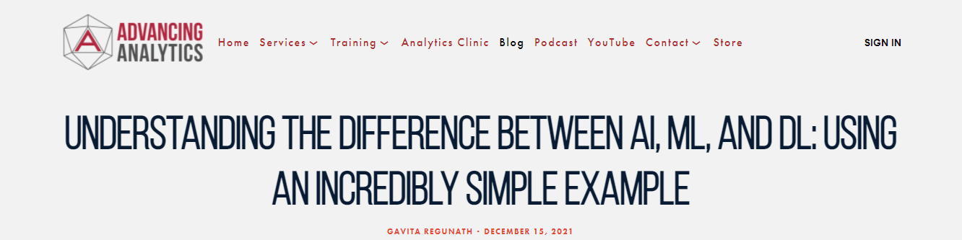
EXAMPLE
“Understanding The Difference Between AI, ML, And DL: Using An Incredibly Simple Example” by Gavita Regunath
Link to blog: https://www.advancinganalytics.co.uk/blog/2021/12/15/understanding-the-difference-between-ai-ml-and-dl-using-an-incredibly-simple-example

Slide 8
MACHINE LEARNING: THE BIG PICTURE
EASY
ADVANCED

Slide 9
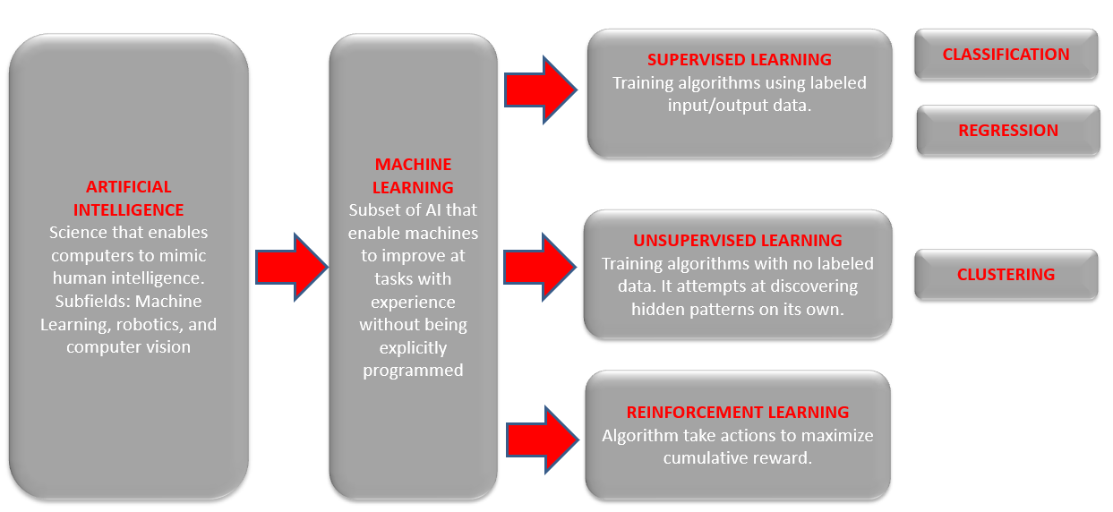
MACHINE LEARNING: BIG PICTURE

Slide 10
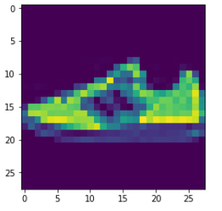
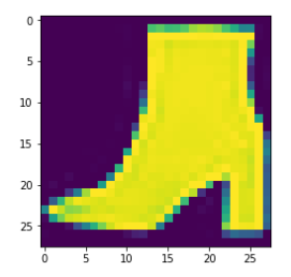
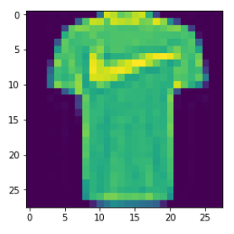
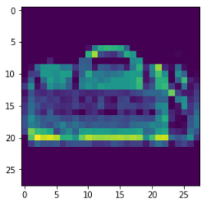

MACHINE LEARNING: SUPERVISED LEARNING
Supervised: used to train algorithms using labeled input and output data.
Performance is assessed by comparing trained model prediction vs. real output.
DESIRED OUTPUT
TARGET CLASSES (LABELS)
y _train
INPUT DATA
$$X _train$$
T-SHIRT/TOP
TROUSER
PULLOVER
DRESS
COAT
SANDAL
SHIRT
SNEAKER
BAG
ANKLE BOOT
MODEL

Slide 11
MACHINE LEARNING: UNSUPERVISED LEARNING
Unsupervised learning: provides the algorithm with no labeled data.
The algorithm attempts at discovering hidden patterns within the training data.
Unsupervised learning methods can analyze complex data that humans might find difficult to interpret.
No feedback!
DATA CLUSTERS
INPUT DATA
MODEL

Slide 12

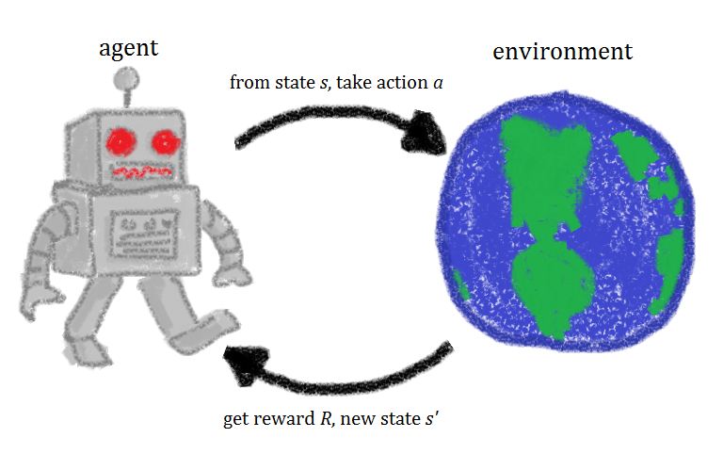


MACHINE LEARNING: REINFORCEMENT LEARNING
Reinforcement learning allows machines take actions to maximize cumulative reward.
Reinforcement algorithms learn by trial and error through reward and penalty.
Two elements: environment and learning agent.
The environment rewards the agent for correct actions.
Based on the reward or penalty, agent improves its environment knowledge to make better decision.
ENVIRONMENT
AGENT
-10 Points
+10 Points
https://commons.wikimedia.org/wiki/File:Rl_agent.png

Slide 13
WHAT ARE THE KEY INGREDIENTS TO BUILD AI/ML MODELS?
EASY
ADVANCED

Slide 14
AI/ML KEY INGREDIENTS
1. DATA
2. MODEL
3. COMPUTE

Slide 15

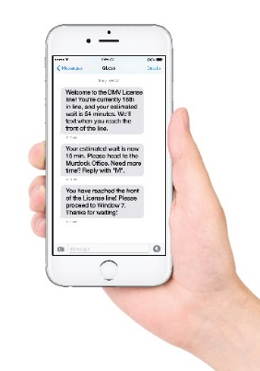



1. DATA
Data can come from so many sources such as images, audio, video, and text.
Collecting, structuring and analysing this data is critical for companies to gain customers insights and set their marketing and product strategies.
IMAGE/VIDEO
TEXT (CORPUS)
AUDIO/SOUND
TIMESERIES/SIGNALS
Photo Credit: https://pxhere.com/en/photo/1454351
Photo Credit: https://www.flickr.com/photos/29881930@N00/2086641598
Photo Credit: https://commons.wikimedia.org/wiki/File:Mobile_phone_text_messages.jpg
Photo Credit: https://en.wikipedia.org/wiki/File:Messages_Yosemite.svg
Photo Credit: https://www.pexels.com/photo/blue-and-yellow-graph-on-stock-market-monitor-159888/

Slide 16
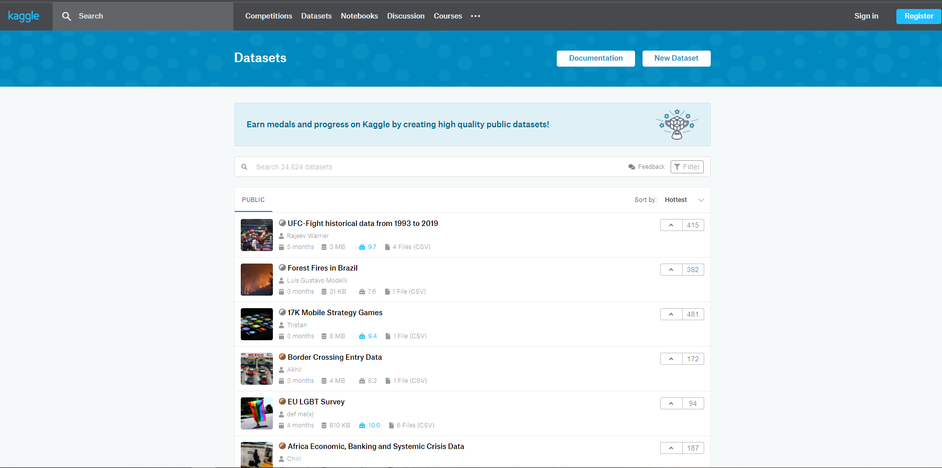
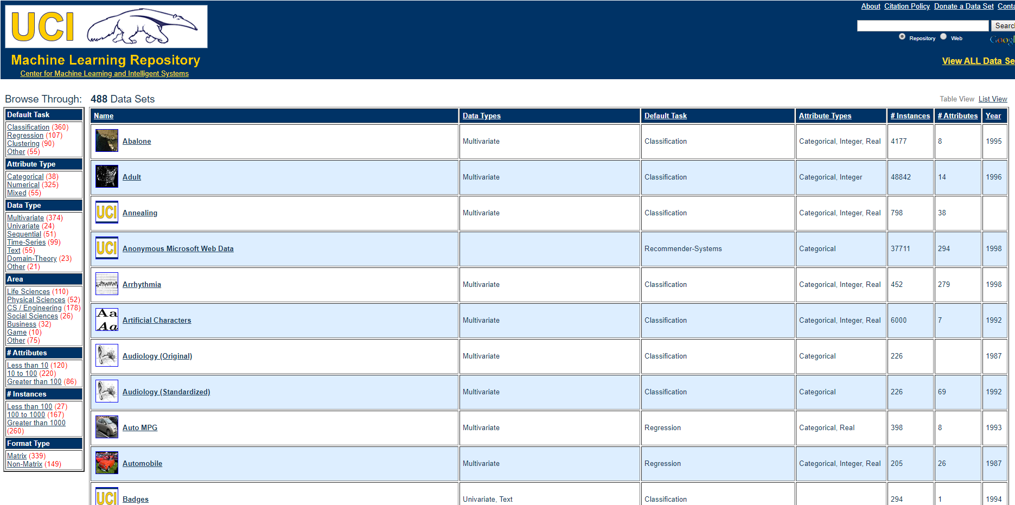
1. DATA: WHERE DOES THIS DATA COME FROM?
Data could also come from multiple sources such as Kaggle and University of California, Irvine (UCI).
Example: ImageNet is an open source repository of images consisting of 21,841 subcategories (classes) and over 14 million images.
Check out website here: https://archive.ics.uci.edu/ml/datasets.php
Check out website here: https://www.kaggle.com/datasets

Slide 17
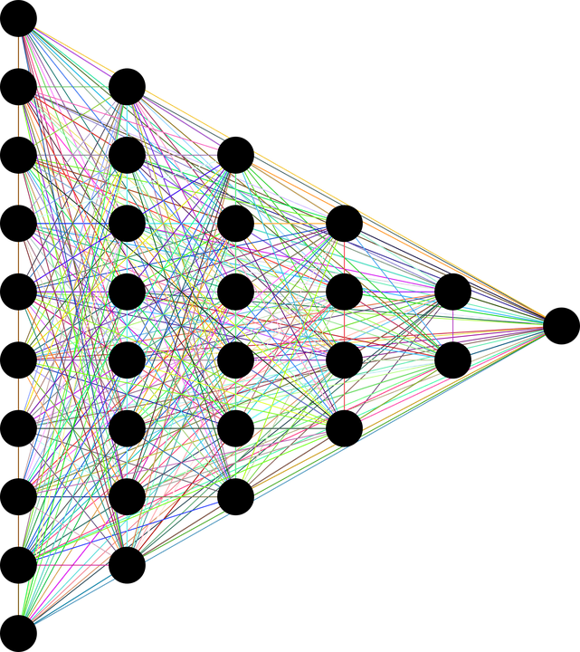

2. MODEL
The human brain consists of billions of neurons that communicate to each other using electrical/chemical signals and enable humans to see, feel, and make decision.
Artificial neural networks (ANNs) are information processing models inspired by the human brain.
Simply, ANNs are couple of equations that mimic the human brain!
INPUT DATA
OUTPUTS
DEEP (HIDDEN LAYERS)
MIMIC HUMAN BRAIN USING MATHEMATICAL EQUATIONS
Photo Credit: https://pixabay.com/en/neural-network-thought-mind-mental-3816319/
Photo Credit: https://commons.wikimedia.org/wiki/File:Voxel-man-brain.jpg

Slide 18
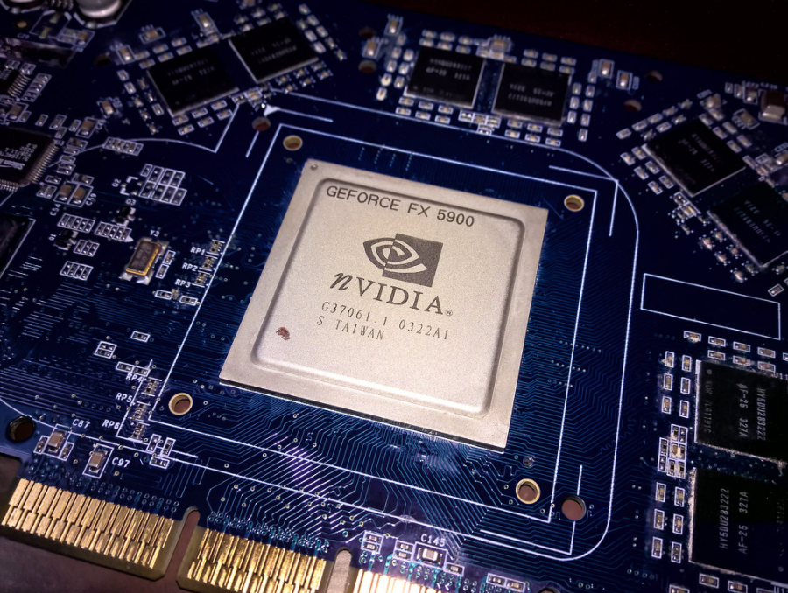
3. COMPUTE
ANN requires computation power to be able to learn from the data.
AI-based specific chips are being developed and optimized for AI training.
The amount of compute has been increasing exponentially with ~3 months doubling time!!
Great article by OpenAI: https://openai.com/blog/ai-and-compute/
Photo Credit: https://www.flickr.com/photos/3336/27830149309

Slide 19
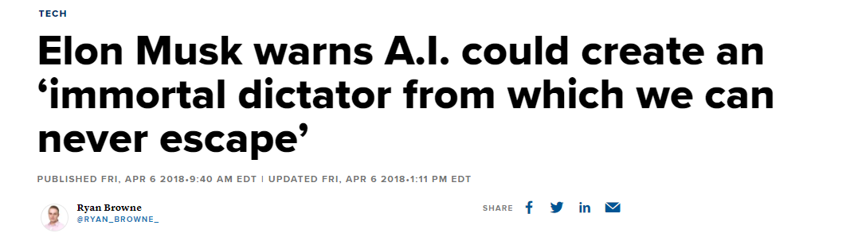
3. COMPUTE: AI IMMORTAL DICTATOR
“The least scary future I can think of is one where we have at least democratized AI because if one company or small group of people manages to develop godlike digital superintelligence, they could take over the world,” Elon Musk.
Link to article: https://www.cnbc.com/2018/04/06/elon-musk-warns-ai-could-create-immortal-dictator-in-documentary.html

Slide 20
MACHINE LEARNING COMPONENTS IN AWS
EASY
ADVANCED

Slide 21
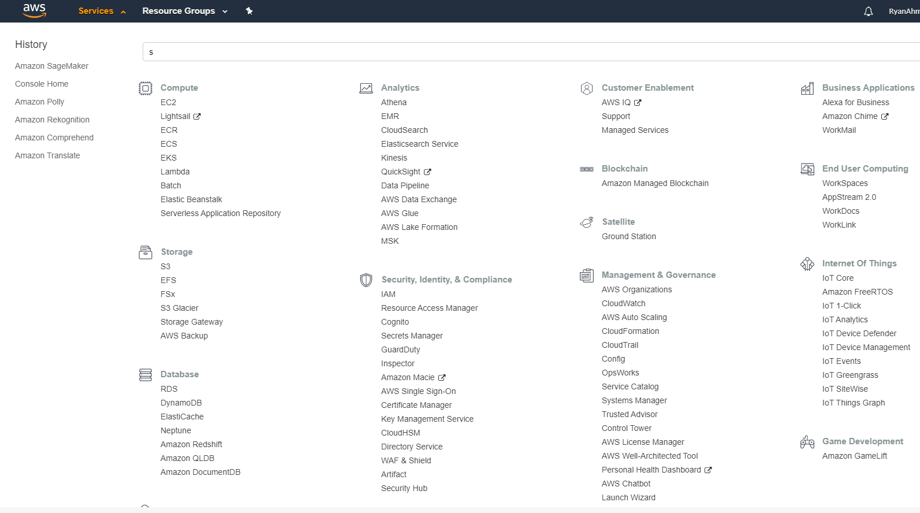
MACHINE LEARNING COMPONENTS IN AWS: 1. DATA
1. DATA
2. MODEL
3. COMPUTE
1

Slide 22
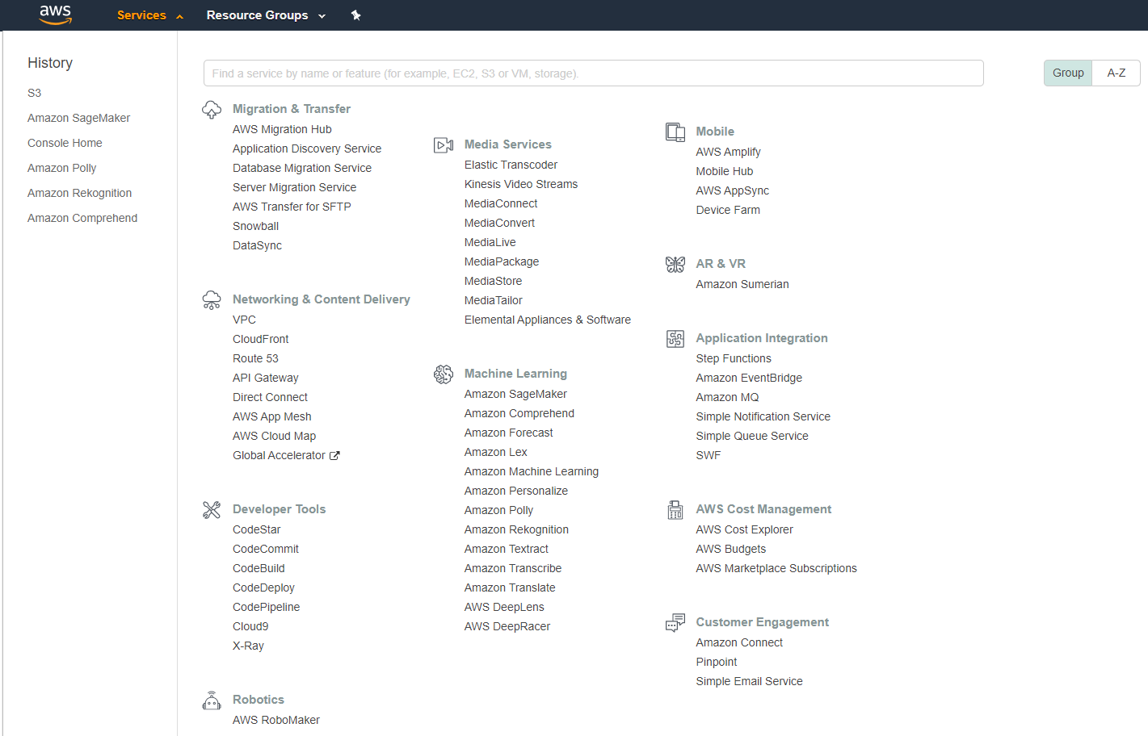
MACHINE LEARNING COMPONENTS IN AWS: 2. MODEL
1. DATA
2. MODEL
3. COMPUTE
2

Slide 23
MACHINE LEARNING COMPONENTS IN AWS: 3. COMPUTE
1. DATA
2. MODEL
3. COMPUTE
3

Slide 24
AMAZON SIMPLE STORAGE SERVICE (S3)
EASY
ADVANCED

Slide 25


WHAT IS AMAZON S3?
Amazon Simple Storage Service (Amazon S3) is a storage service that allows enterprises/individuals to store and protect any amount of data.
Amazon S3 is extremely easy to use and allows enterprises to organize their data and configure finely-tuned access controls.
Amazon S3 extremely durable to 99.999999999% (11 9’s).
Amazon S3 is 99.9% available.
Amazon S3 offers numerous enhanced features such as:
(1) Scalability
(2) Data availability
(3) Security
(4) Performance
Photo Credit: https://commons.wikimedia.org/wiki/File:AWS_Simple_Icons_AWS_Cloud.svg
Photo Credit: https://commons.wikimedia.org/wiki/File:AWS_Simple_Icons_Storage_Amazon_S3.svg

Slide 26
WHAT IS AMAZON S3? CONTINUED
Amazon Simple Storage Service (Amazon S3) is built to be extremely simple and robust.
Amazon S3 allows customers to store data in buckets or directories (much like folders).
A bucket is a container for objects stored in Amazon S3. Objects are contained in buckets.
Each of the buckets will have global (universal) unique name. So, you cannot have the same bucket name as somebody else!
You can store an infinite amount of data in a bucket in which each object can contain up to 5 TB of data.
S3 allows anyone to collect, store and analyze the data from anywhere and in any amount.
Data is stored on 3 different availability zones to ensure data protection.
S3 data is fully encryption to ensure compliance and security.
Great video by AWS: https://www.youtube.com/watch?v=_I14_sXHO8U&t
Photo Credit: https://commons.wikimedia.org/wiki/File:AWS_Simple_Icons_AWS_Cloud.svg
Photo Credit: https://commons.wikimedia.org/wiki/File:AWS_Simple_Icons_Storage_Amazon_S3.svg

Slide 27
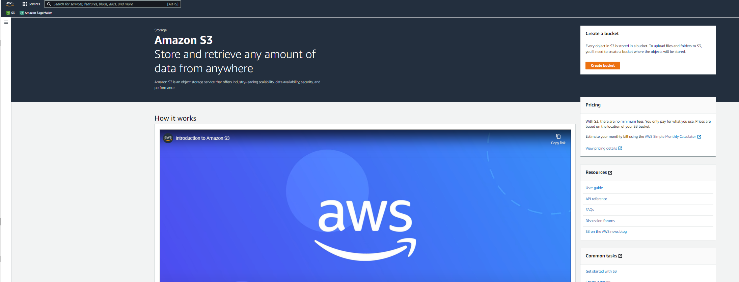
CREATE A BUCKET AND SIMPLY UPLOAD DATA TO IT
WHAT IS AMAZON S3?

Slide 28
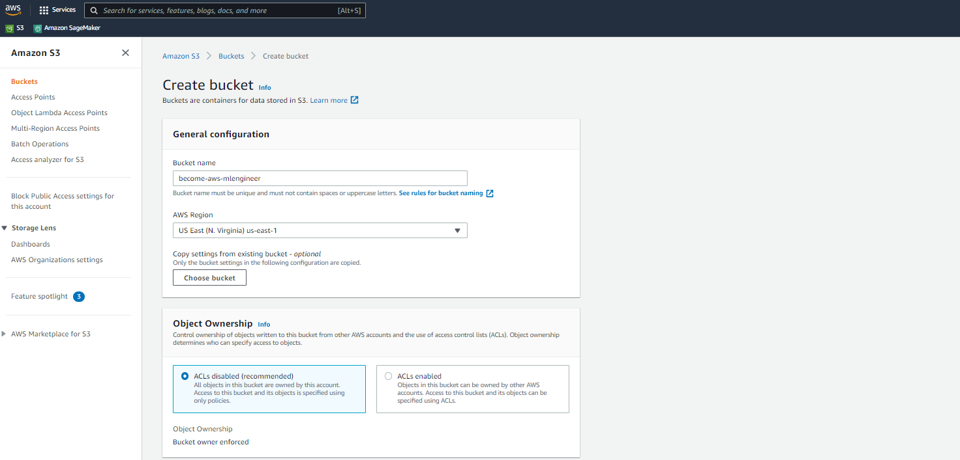
DEMO: AWS MANAGEMENT CONSOLE
GIVE A NAME TO THE BUCKET, ENABLE ENCRYPTION AND CLICK CREATE

Slide 29
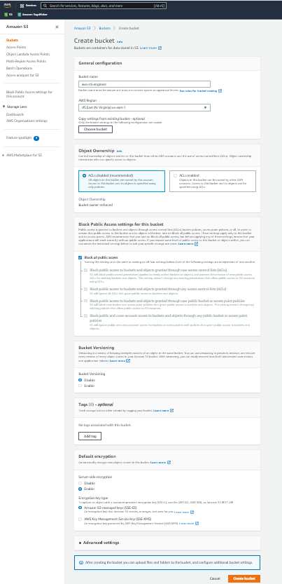
DEMO: AWS MANAGEMENT CONSOLE

Slide 30
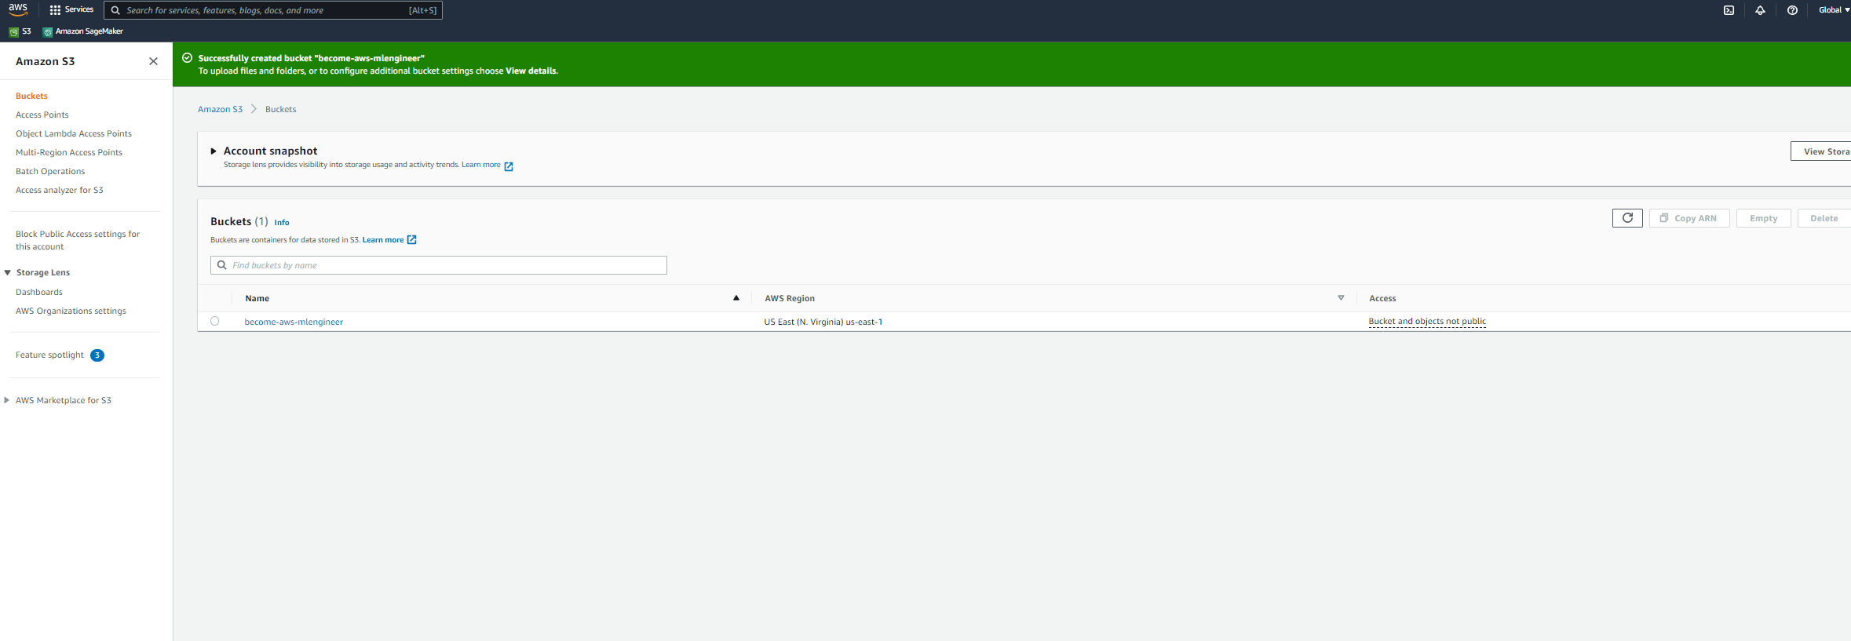
DEMO: AWS MANAGEMENT CONSOLE
BUCKET IS NOW AVAILABLE, YOU CAN UPLOAD DATA TO THE BUCKET

Slide 31
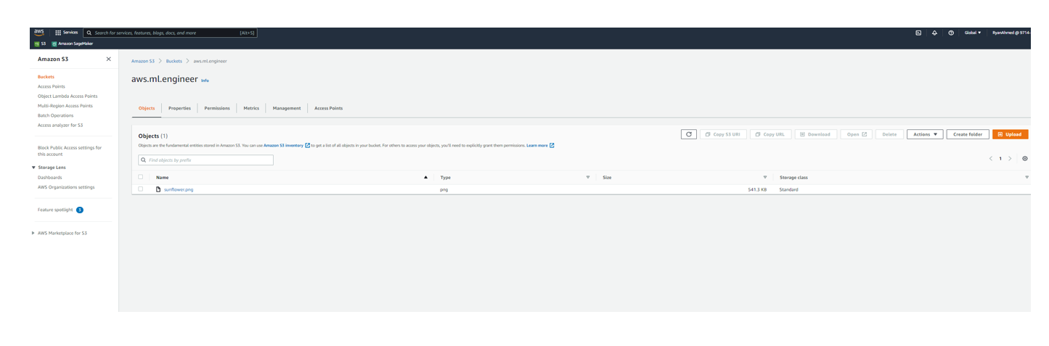
DEMO: AWS MANAGEMENT CONSOLE
UPLOAD A PNG IMAGE TO THE NEWLY CREATED BUCKET

Slide 32
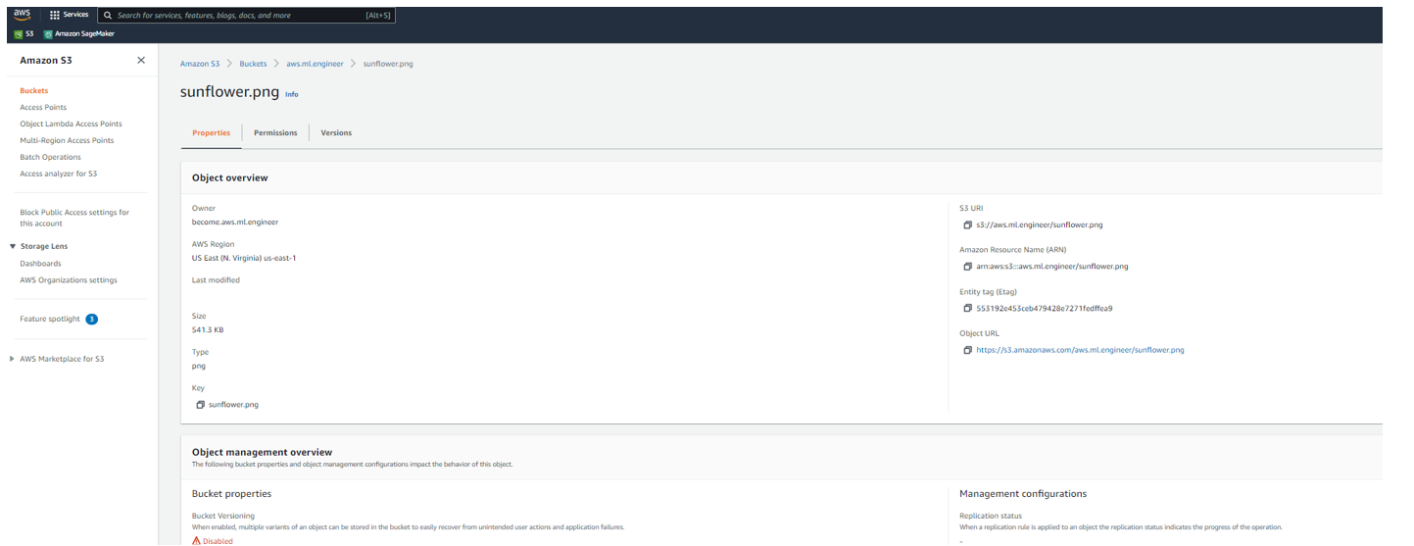
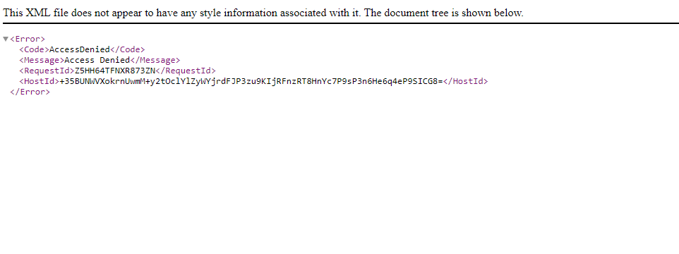
DEMO: AWS MANAGEMENT CONSOLE
CLICK ON THE OBJECT URL, YOU WILL GET THE ACCESS DENIED MESSAGE BELOW SINCE THE BUCKET IS NOT OPEN TO THE PUBLIC

Slide 33
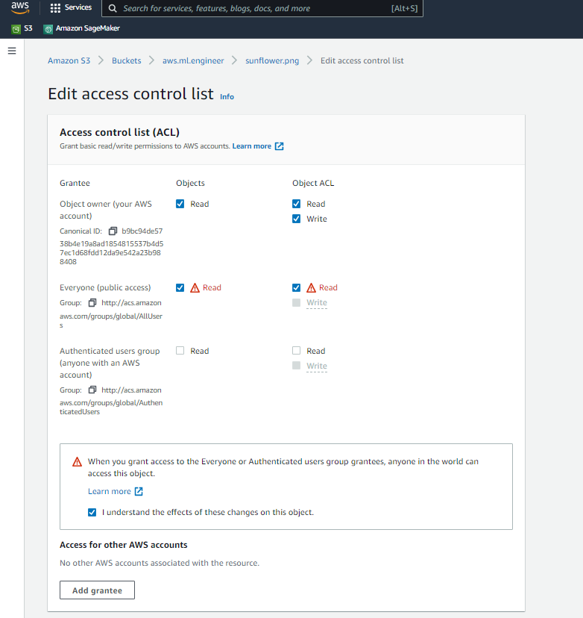
DEMO: AWS MANAGEMENT CONSOLE
CLICK ON PERMISSIONS AND THEN SELECT READ ACCESS

Slide 34

DEMO: AWS MANAGEMENT CONSOLE
NOW YOU SHOULD SEE THE IMAGE

Slide 35
AMAZON ELASTIC COMPUTE CLOUD (EC2)
EASY
ADVANCED

Slide 36


AMAZON EC2: INTRODUCTION
Amazon Elastic Compute Cloud (EC2) offers resizable compute capacity in the cloud.
AWS EC2 can be used to acquire, configure and scale capacity in a very easy fashion.
EC2 is a service that allows you to simply rent a server in the cloud.
EC2 offers 7x fewer downtime hours than the next largest cloud provider.
EC2 covers 22 regions and 69 availability zones all over the world.
Note: EC2 is a compute service which is NOT serverless (lambda is serverless).
AMAZON EC2
Photo Credit: https://pixabay.com/photos/transistors-gpu-processor-pc-chip-1137502/

Slide 37
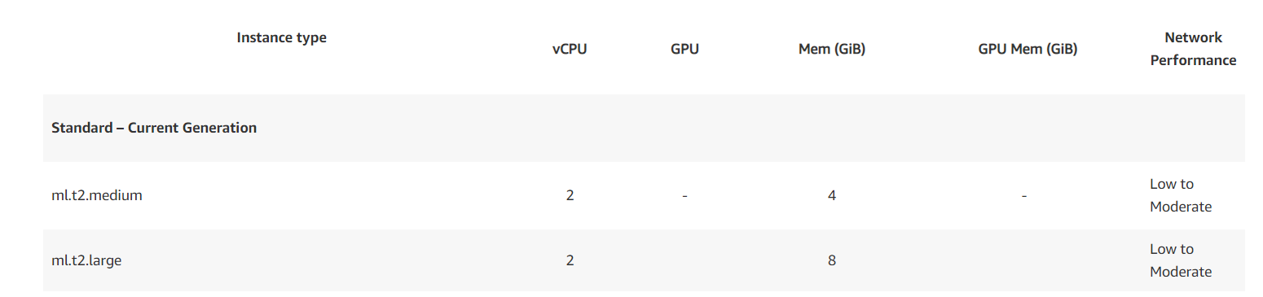
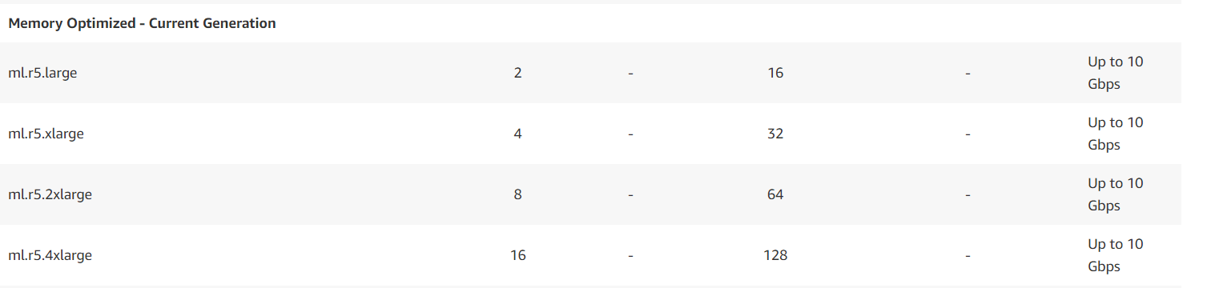
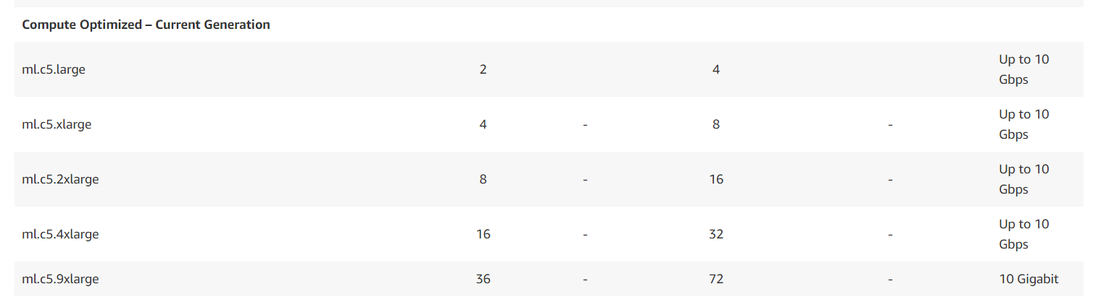
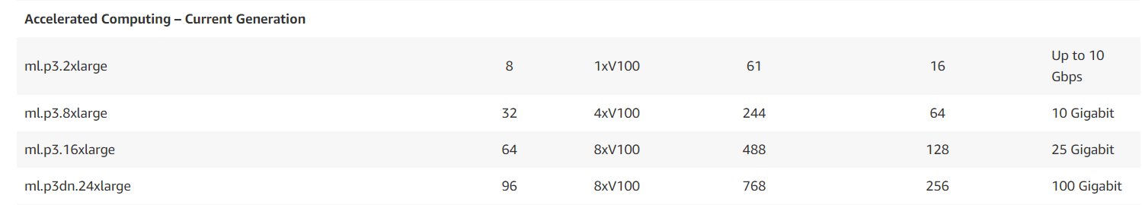
AMAZON EC2: INSTANCE TYPES SELECTION
Check this out for a full list of ML instance Types: https://aws.amazon.com/sagemaker/pricing/instance-types/
STANDARD
MEMORY OPTIMIZED
COMPUTE OPTIMIZED
ACCELERATED COMPUTING

Slide 38
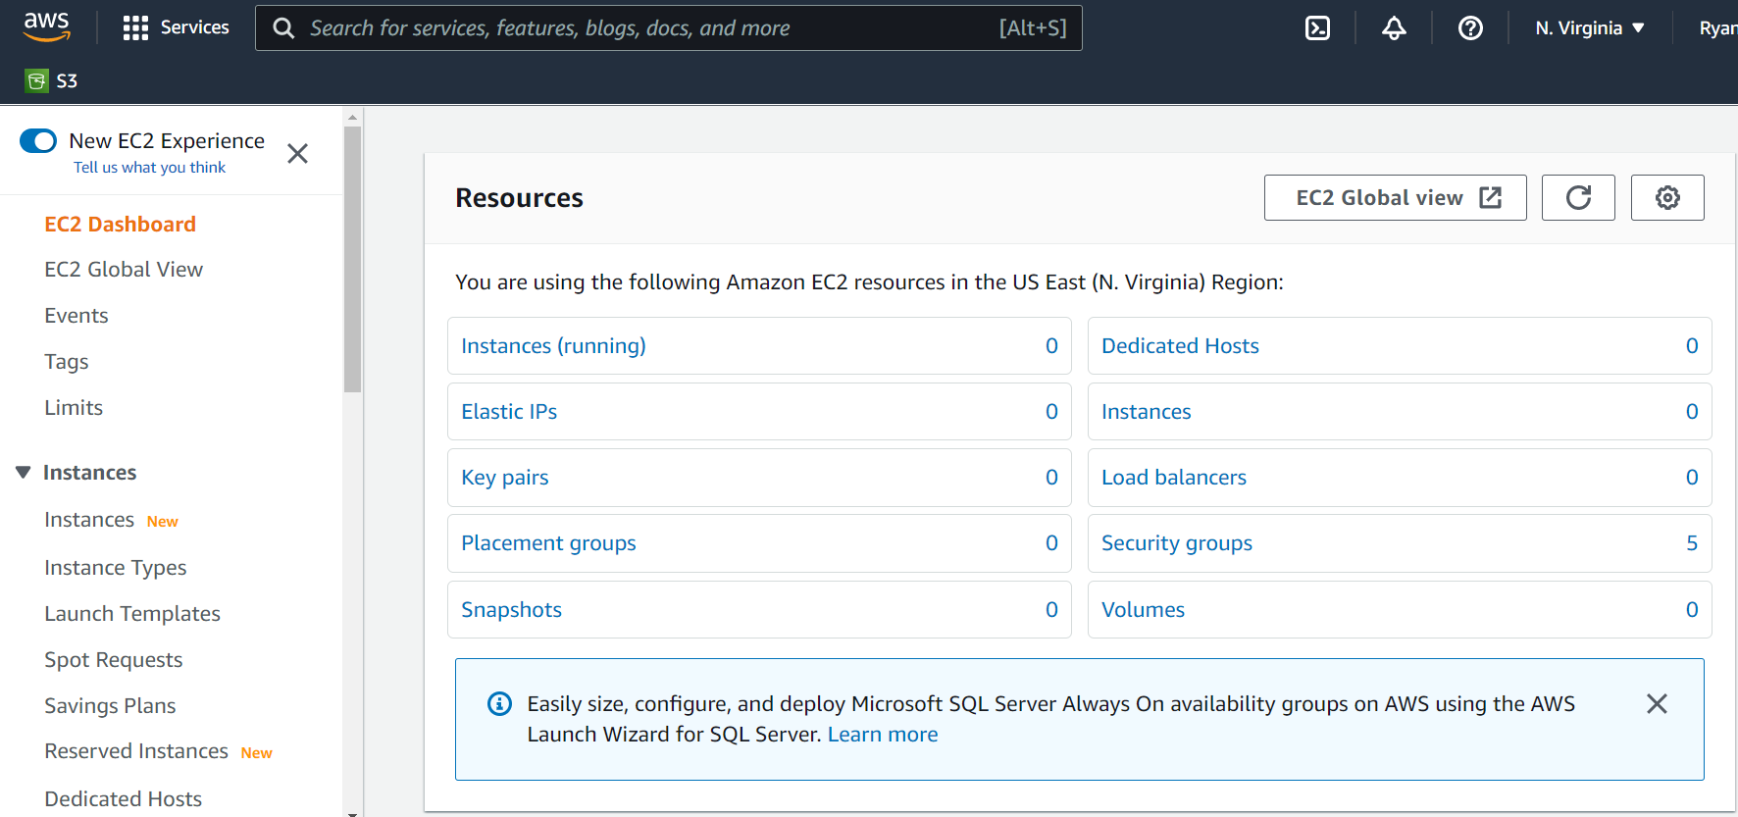
AMAZON EC2: DEMO
NAVIGATE TO EC2 AND CLICK ON INSTANCES

Slide 39
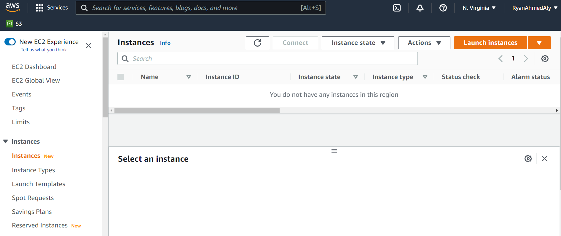
AMAZON EC2: DEMO
CLICK ON LAUNCH INSTANCES

Slide 40
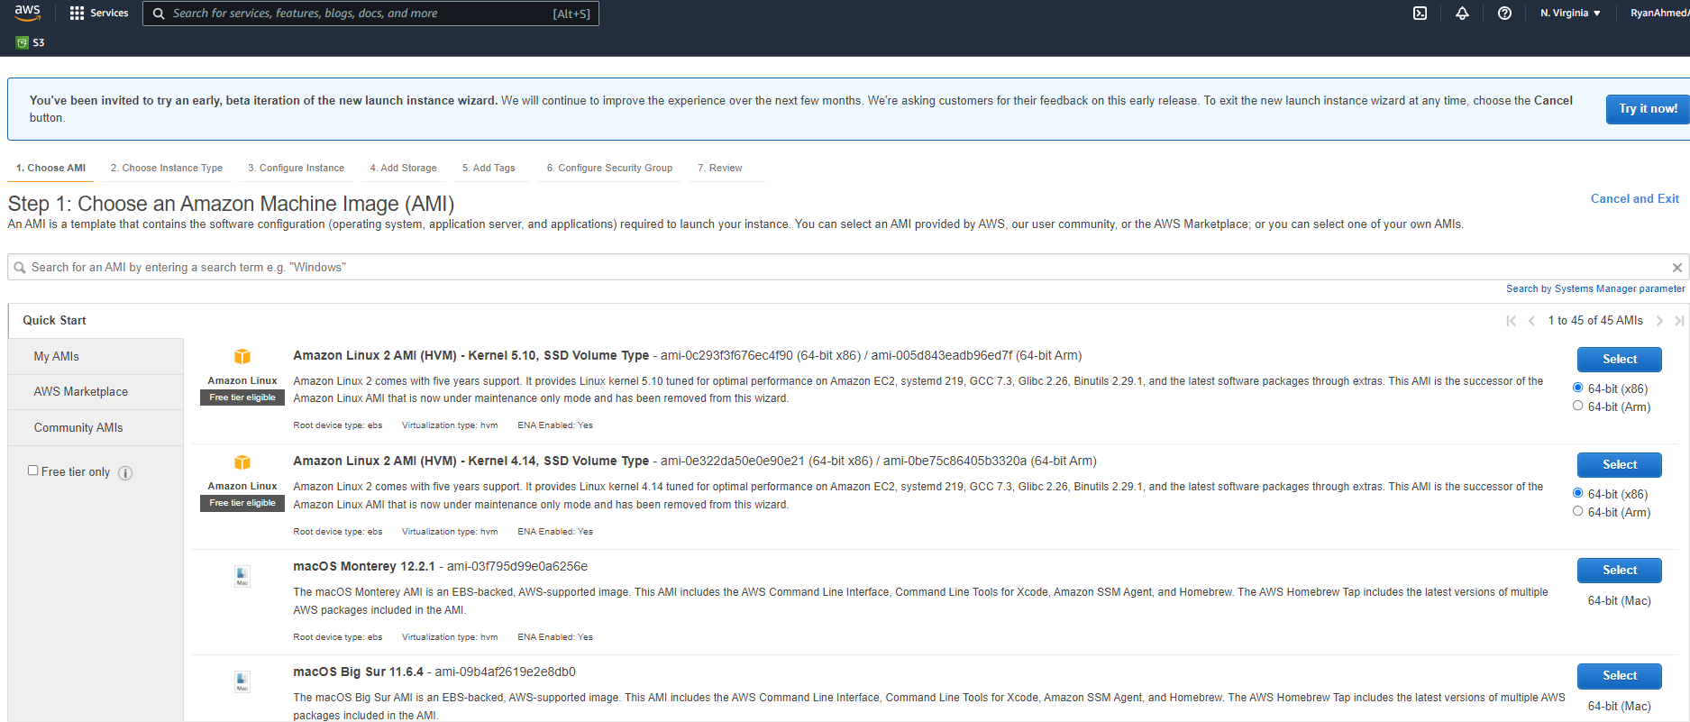
AMAZON EC2: DEMO
CHOOSE THE AMI: MICROSOFT WINDOWS SERVER 2019 BASE

Slide 41
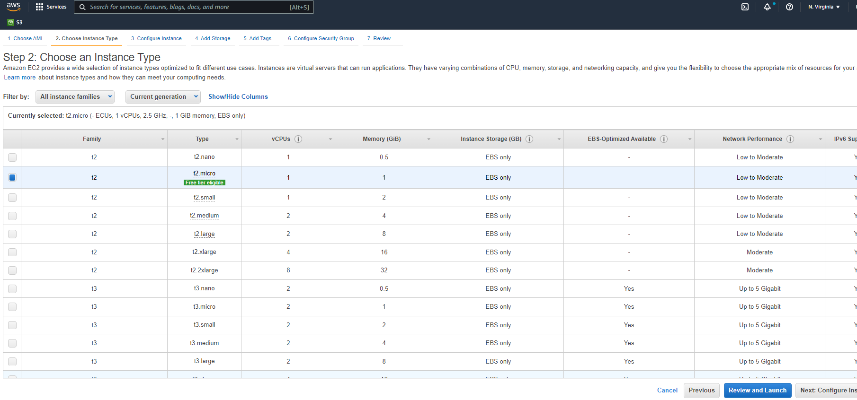
AMAZON EC2: DEMO
SELECT t2 MICRO AND CLICK CONFIGURE INSTANCE DETAILS

Slide 42
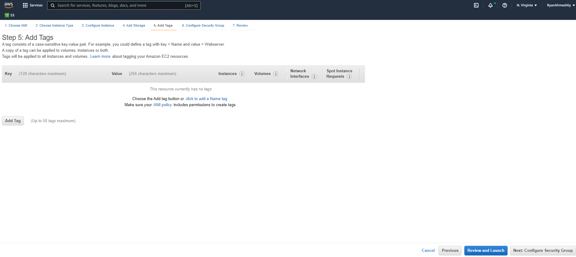
AMAZON EC2: DEMO
SKIP ADD TAGS AND CLICK ON CONFIGURE SECURITY GROUP

Slide 43
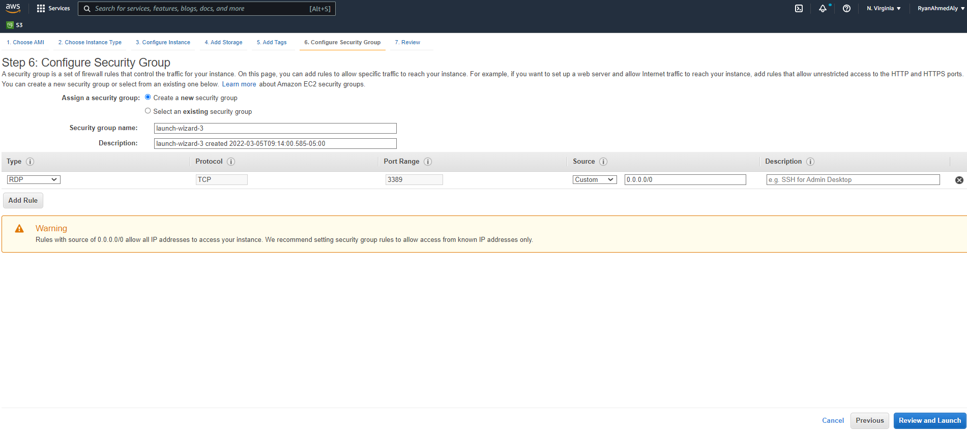
AMAZON EC2: DEMO
KEEP DEFAULT VALUES AND CLICK ON REVIEW AND LAUNCH

Slide 44
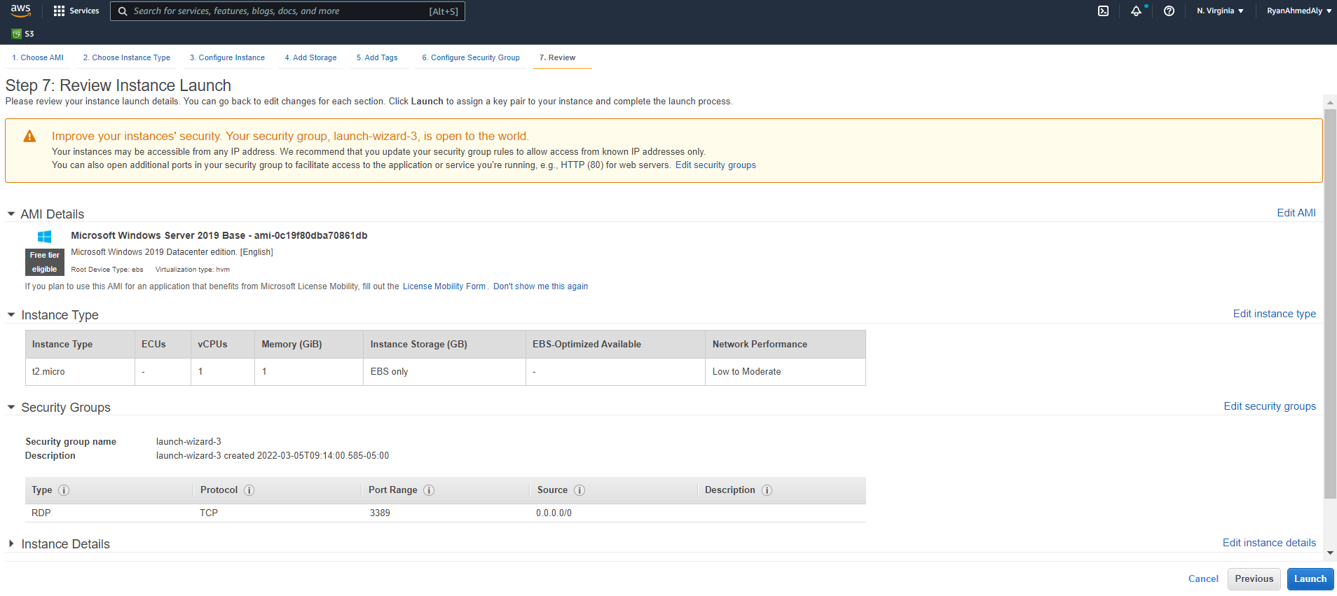
AMAZON EC2: DEMO
CLICK ON LAUNCH

Slide 45
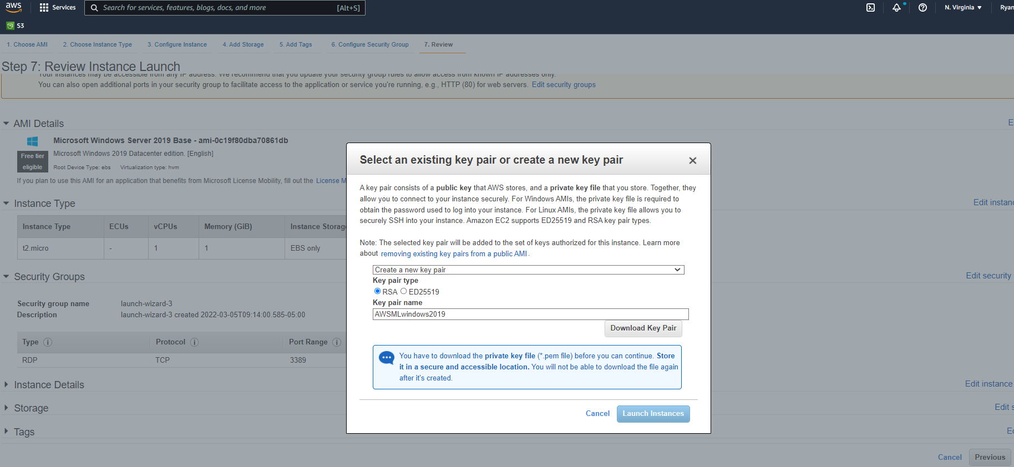
AMAZON EC2: DEMO
CREATE A NEW KEY PAIR AND CLICK DOWNLOAD KEY PAIR. KEEP THAT DOWNLOADED FILE IN A SAFE PLACE

Slide 46
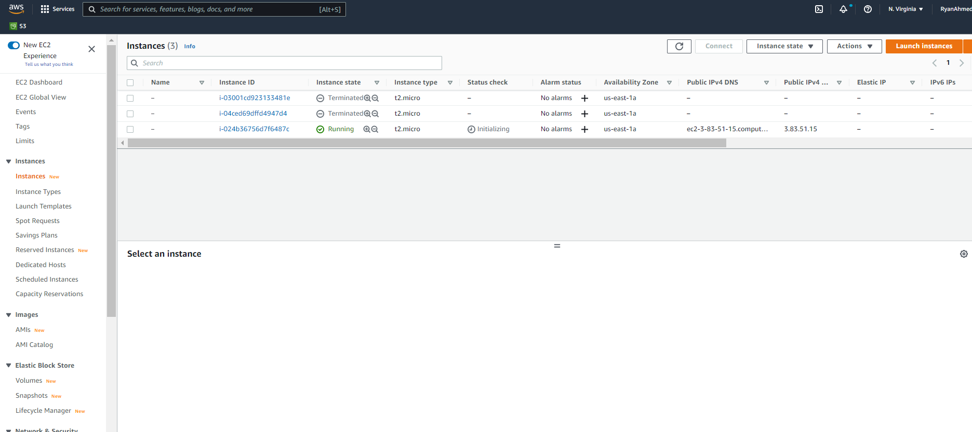
AMAZON EC2: DEMO
UNDER ISTANCES, YOU SHOULD FIND OUR NEWLY CREATED INSTANCE

Slide 47
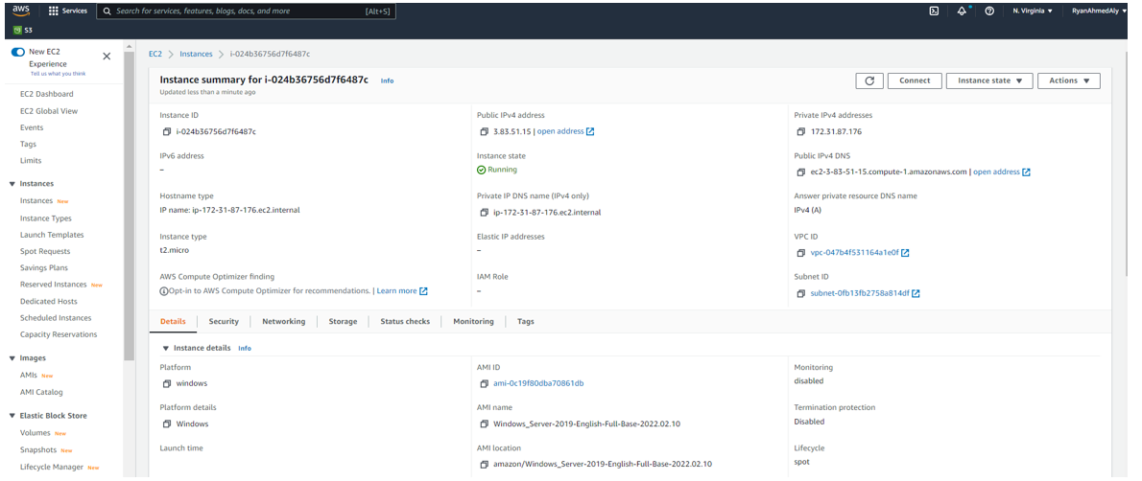
AMAZON EC2: DEMO
GO TO THE INSTANCE AND CLICK CONNECT.

Slide 48
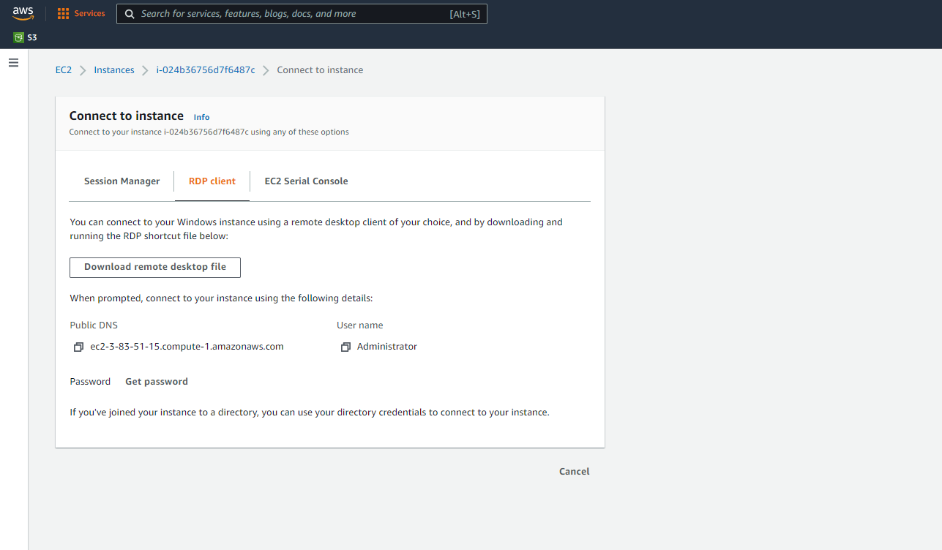
AMAZON EC2: DEMO
SELECT RDP CLIENT AND CLICK ON DOWNLOAD REMOTE DESKTOP FILE

Slide 49
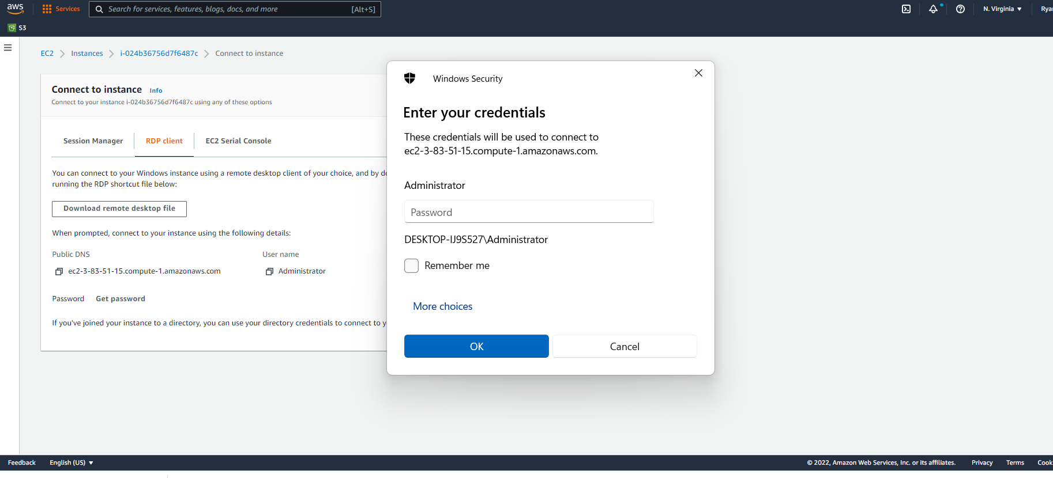
AMAZON EC2: DEMO
OPEN THE DOWNLOADED FILE, NOTE THAT YOU NEED A PASSWORD NOW

Slide 50
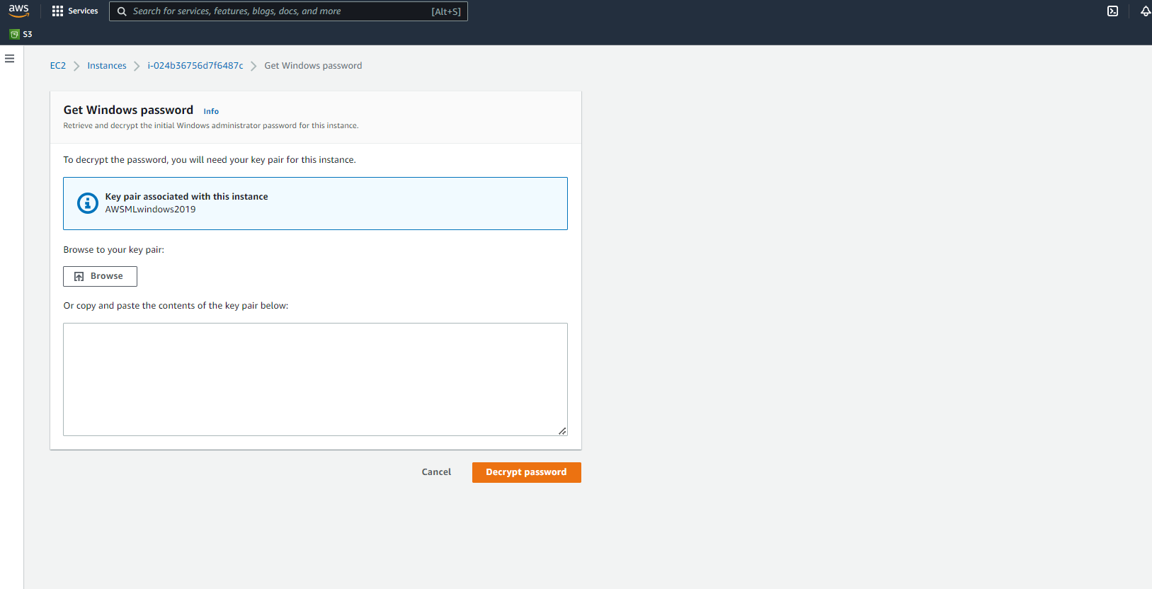
AMAZON EC2: DEMO
CLICK ON GET PASSWORD, UPLOAD THE KEY PAIR FILE “AWSMLwindows2019” ASSOCIATED WITH THIS INSTANCE

Slide 51
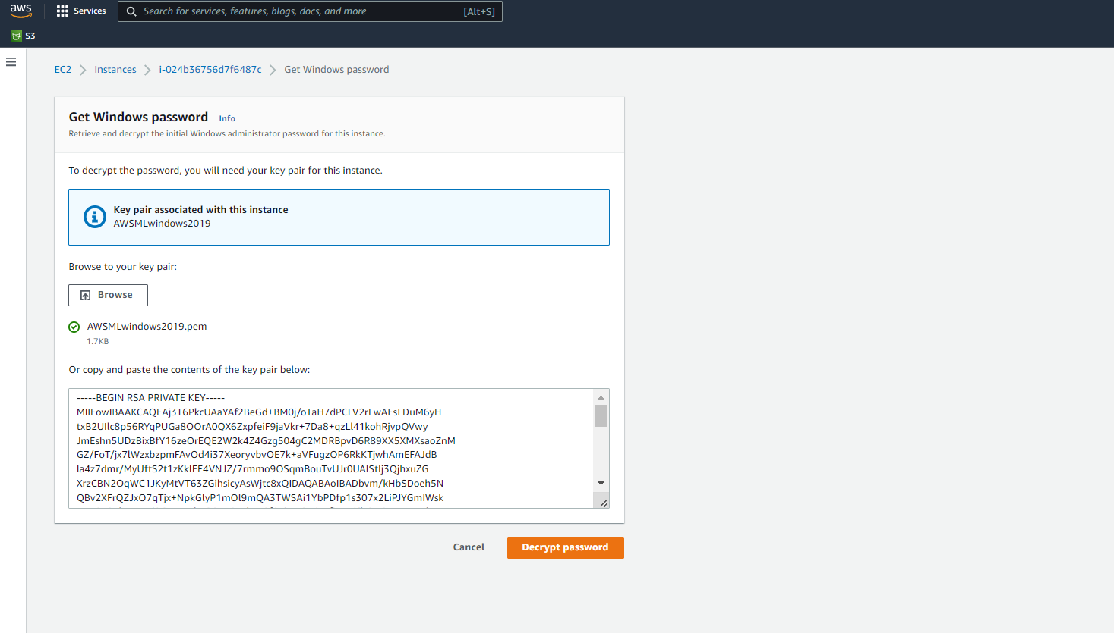
AMAZON EC2: DEMO
DECRYPT PASSWORD

Slide 52
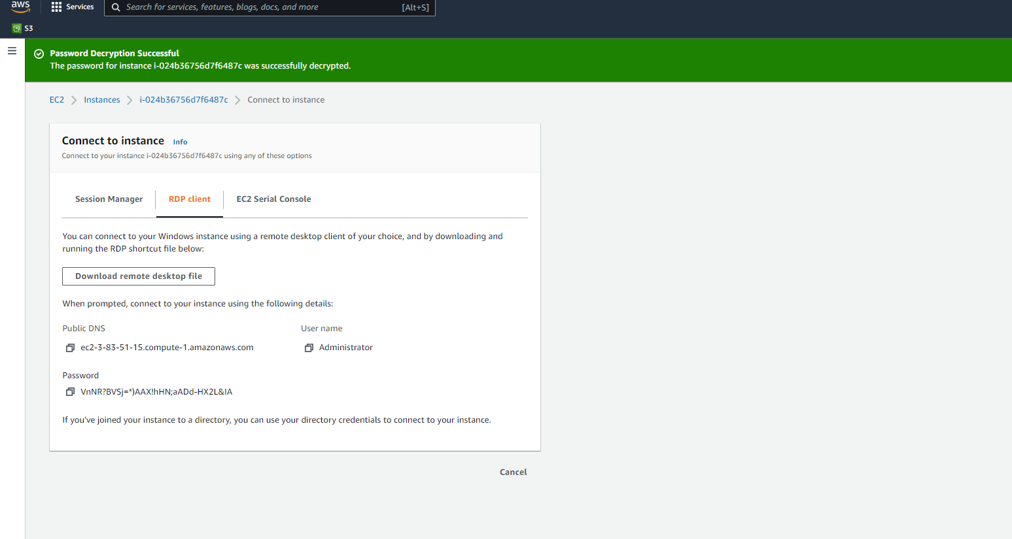
AMAZON EC2: DEMO
COPY THE PASSWORD AND USE IT TO LOG IN THE VIRTUAL MACHINE

Slide 53
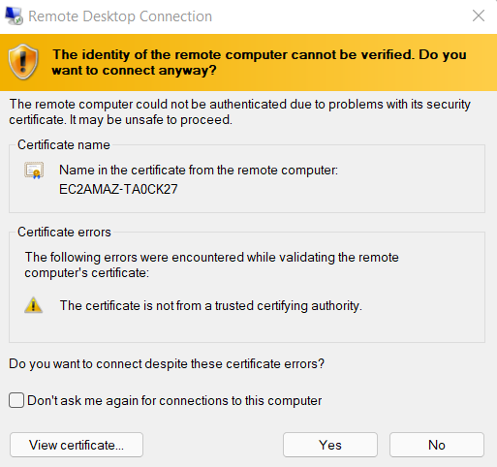
AMAZON EC2: DEMO
CLICK YES

Slide 54
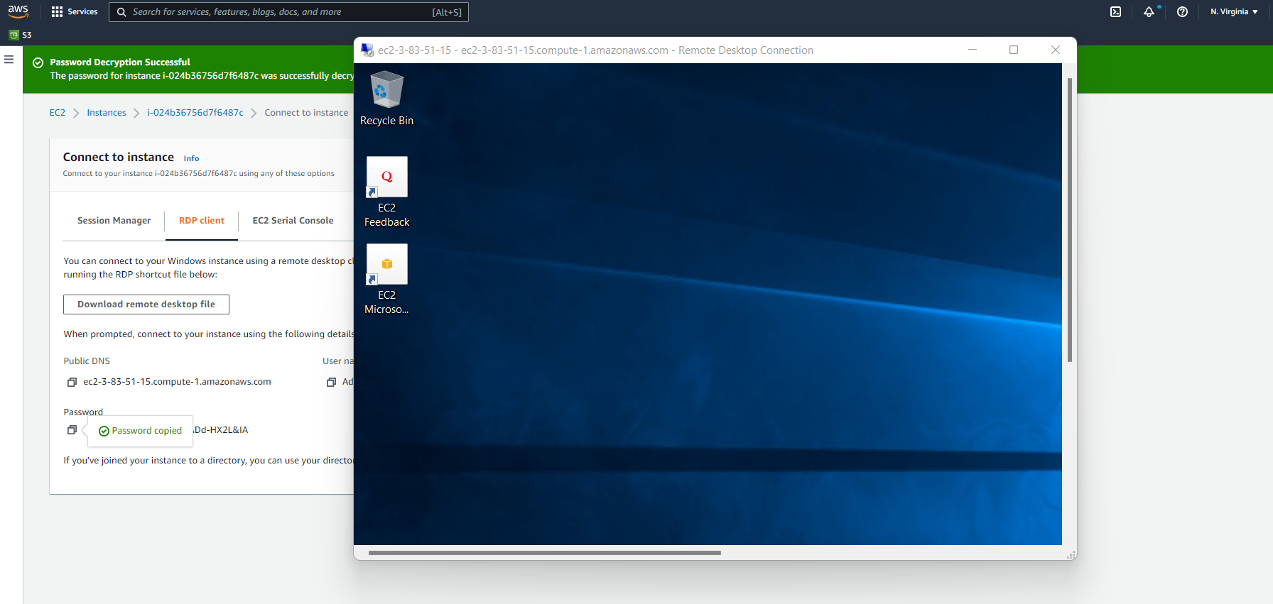
AMAZON EC2: DEMO
CONGRATULATIONS! YOU NOW HAVE A VIRTUAL MACHINE RUNNING WITH SPOT INSTANCE OPTION

Slide 55
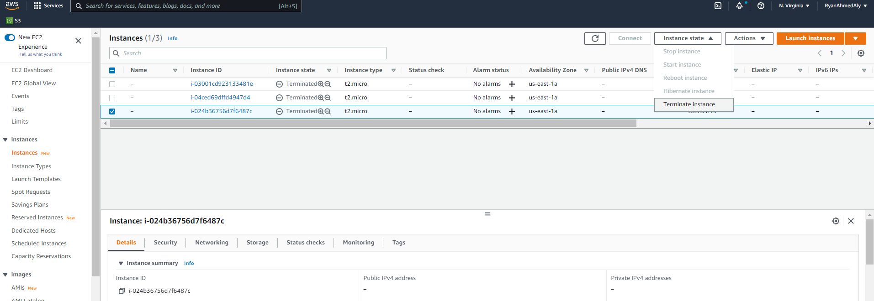
AMAZON EC2: DEMO
CLICK ON THE INSTANCE AND TERMINATE INSTANCE

